Slide 1

DevOps & Cloud Infrastructure SEIS 665 Week 1: Git
Jason Baker
Adjunct Instructor
Graduate Programs in Software
University of St. Thomas
St. Paul, MN

Slide 2

Agenda
Introduction to the course
Review syllabus
Source control management & Git

Slide 3
About Your Instructor
2015 Graduate of UST GPS program with M.S. in Software Engineering
20+ years in IT working with tech startups and Fortune 500
Co-founded the largest datacenter company in Minnesota.
Currently DevOps Engineer with Spok
AWS Certified Solutions Architect & Developer
Hobbies include underwater photography, cycling, analog synths, and woodworking.

Slide 4
Introduce yourself
Your name….
What do you hope to learn in this class?

Slide 5

What’s DevOps
When do we consider software done?

Slide 6
DevOps defined
Is software done when a developer finishes writing the code?
How about when it’s reviewed?
Maybe when it’s tested?

Slide 7
DevOps defined
Software is done when it’s delivered to the customer.
(And then the process starts all over again…)
Software doesn’t provide any value to anyone until it’s actually used.
DevOps is primarily concerned with this software delivery lifecycle.

Slide 8
DevOps defined
DevOps is a culture that embraces collaboration and automation to accelerate the process of software delivery and infrastructure change.
-- My definition loosely based on Wikipedia

Slide 9
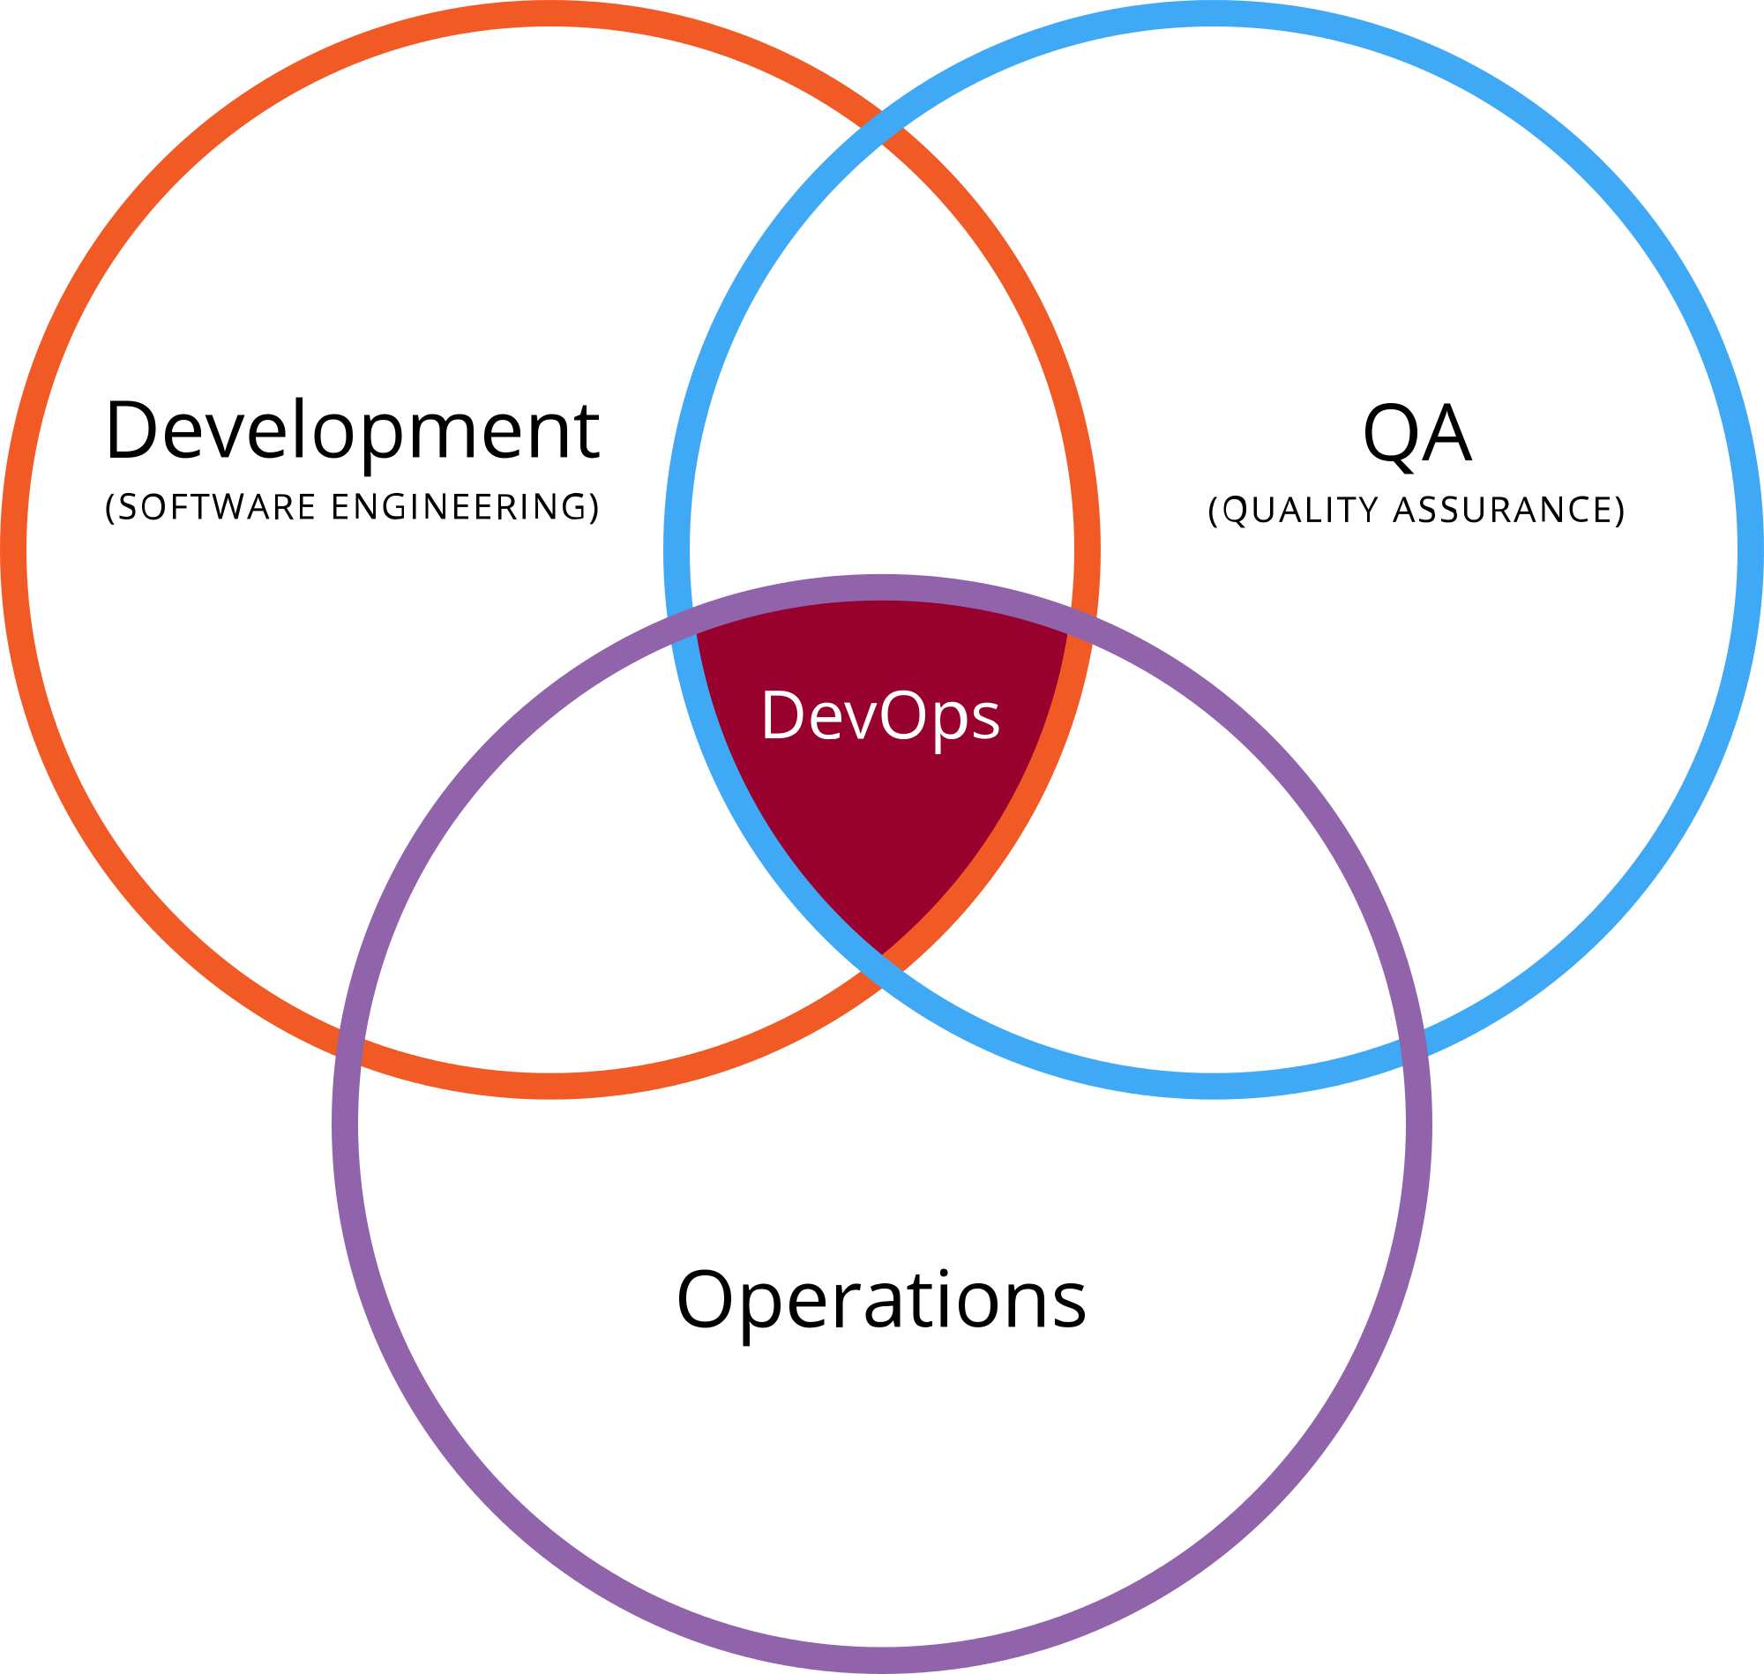
What is DevOps?
A methodology combining multiple practices within the IT organization.

Slide 10
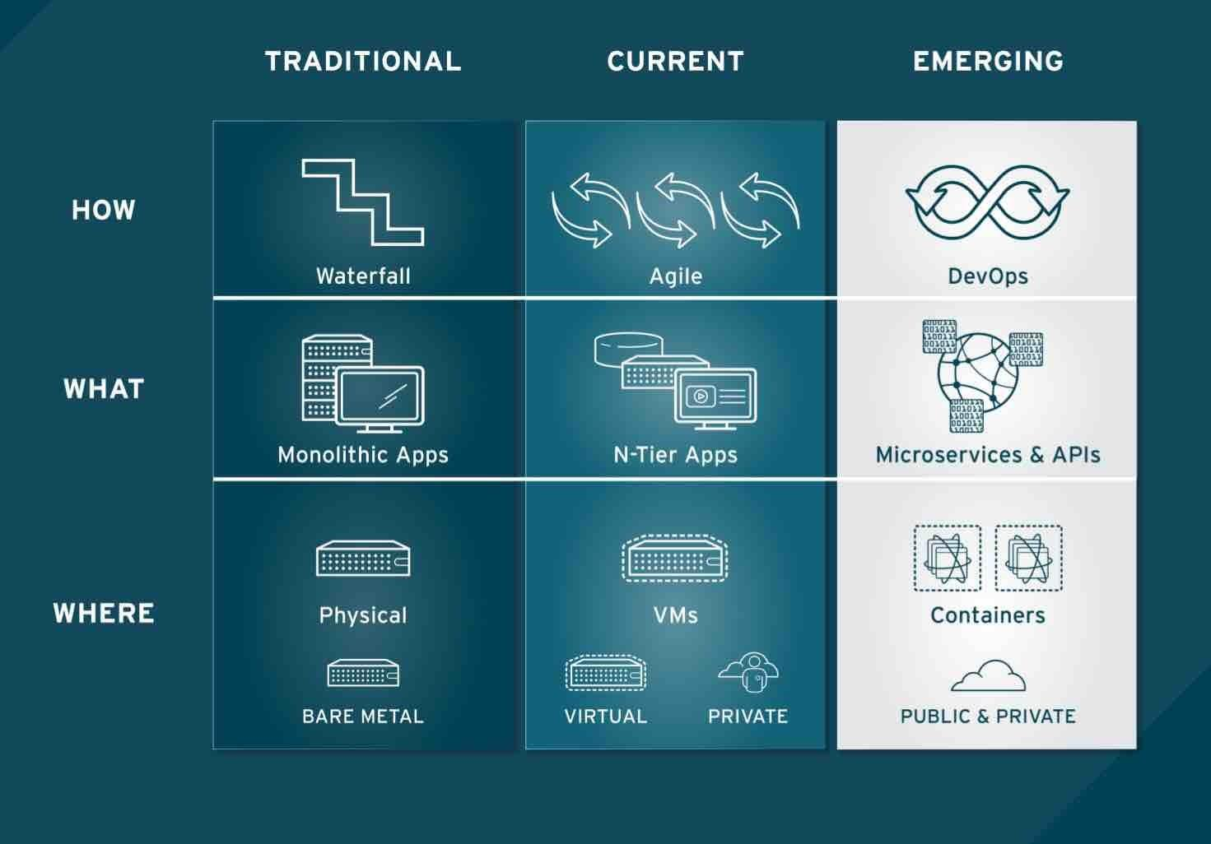
What is DevOps?
The evolution of technology.

Slide 11
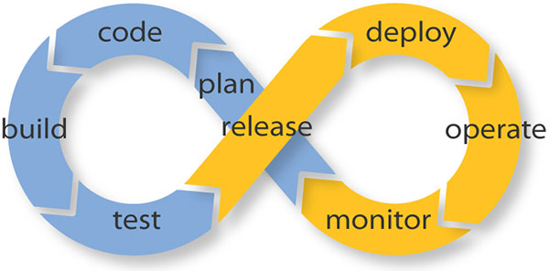
What is DevOps?
A collaborative effort to improve the quality and velocity of the service lifecycle.

Slide 12
Velocity
What do we mean by service velocity?
Amazon deploys code to production at least every 11.6 seconds (and this was back in 2011!)
Netflix deploys new software releases thousands of times a day.

Slide 13
Why does DevOps matter?
2016 State of DevOps Report:
Survey of over 25,000 technology professionals over 5 years.
An attempt to quantitatively understand how technical and cultural practices associated with DevOps affect IT performance.
Categorized IT organizations as High, Medium or Low performers.

Slide 14
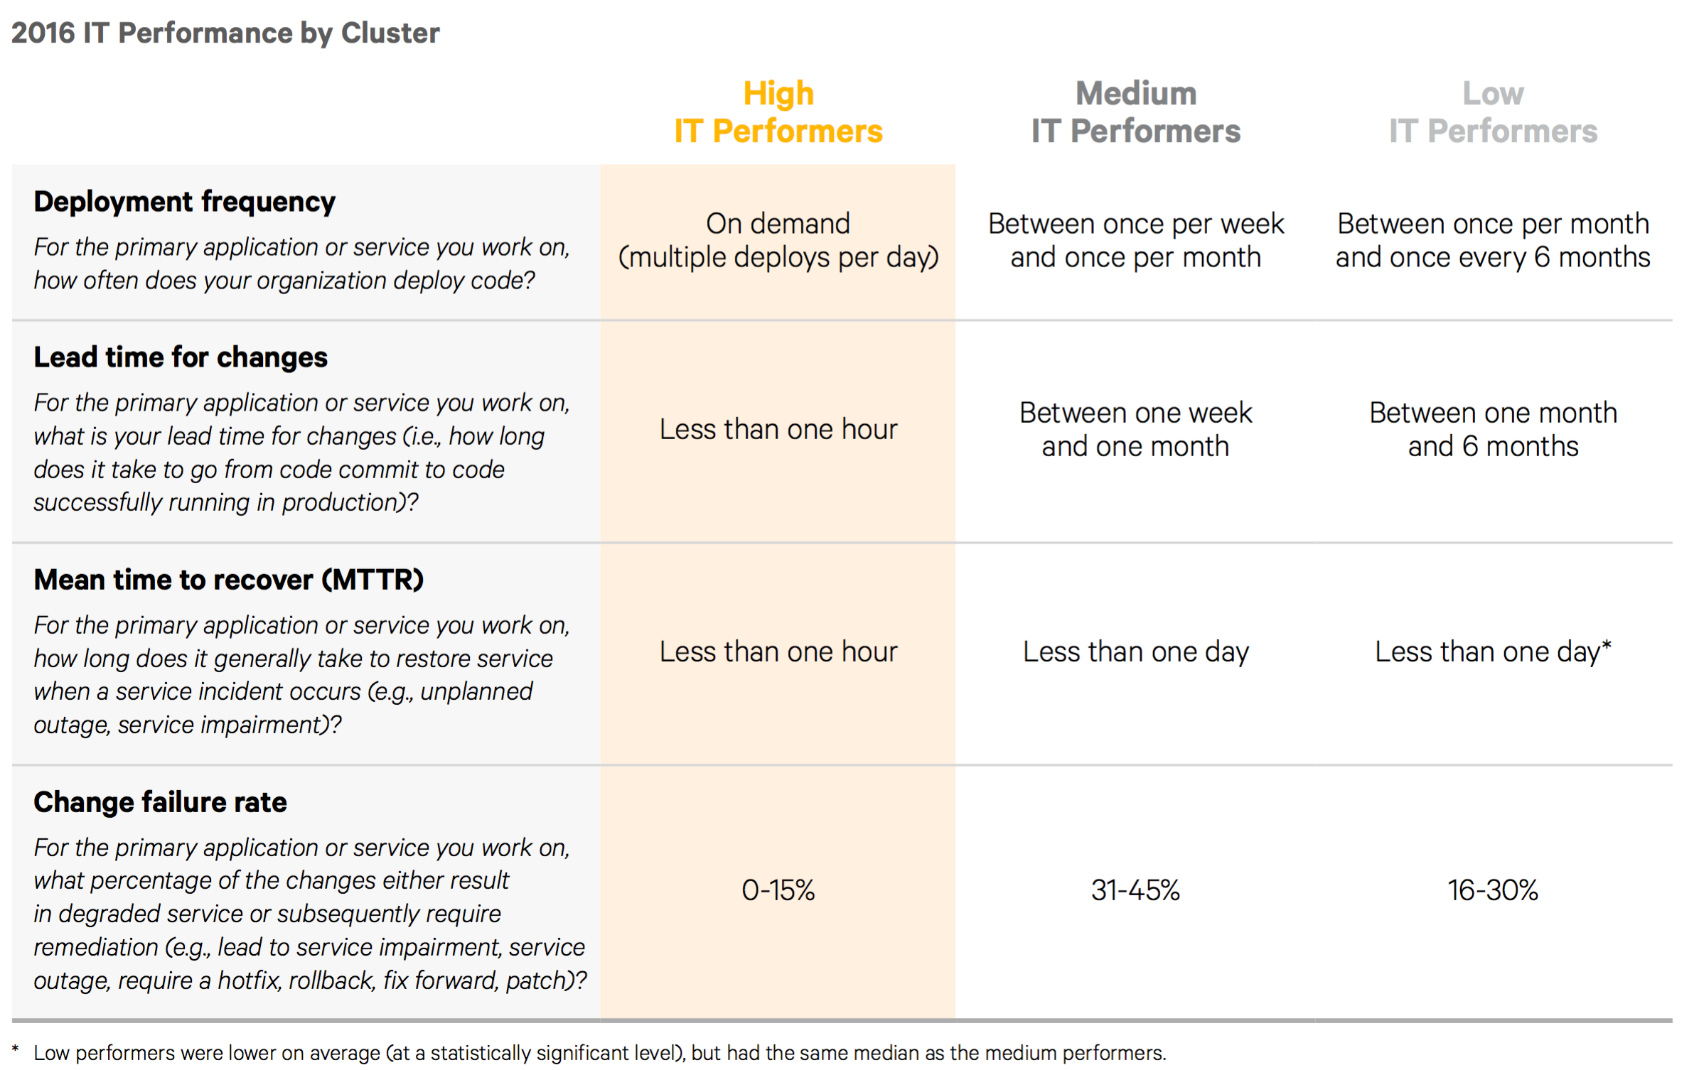

Slide 15
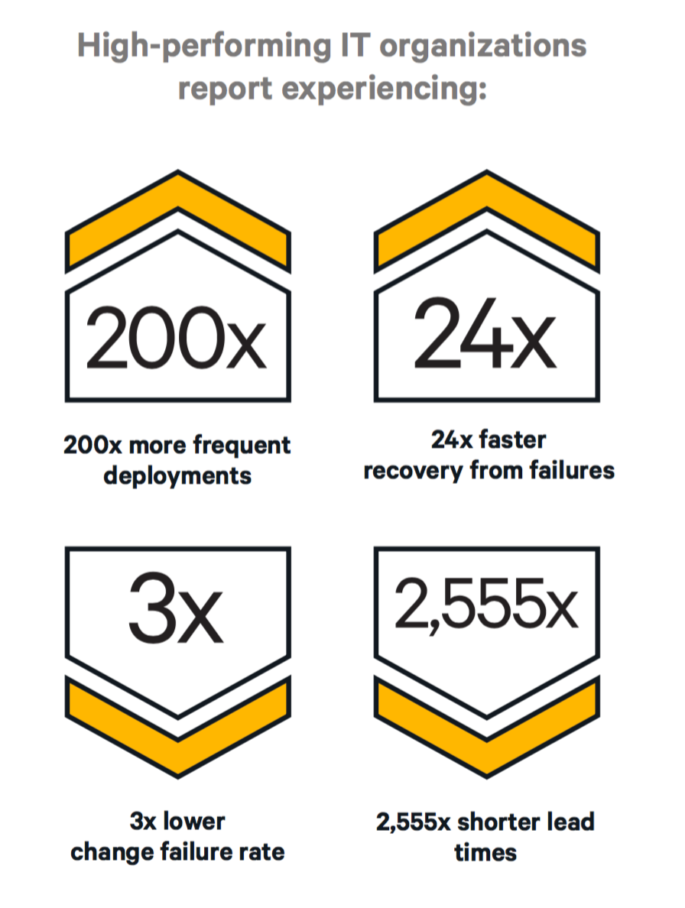
Source: 2016 State of DevOps Report

Slide 16
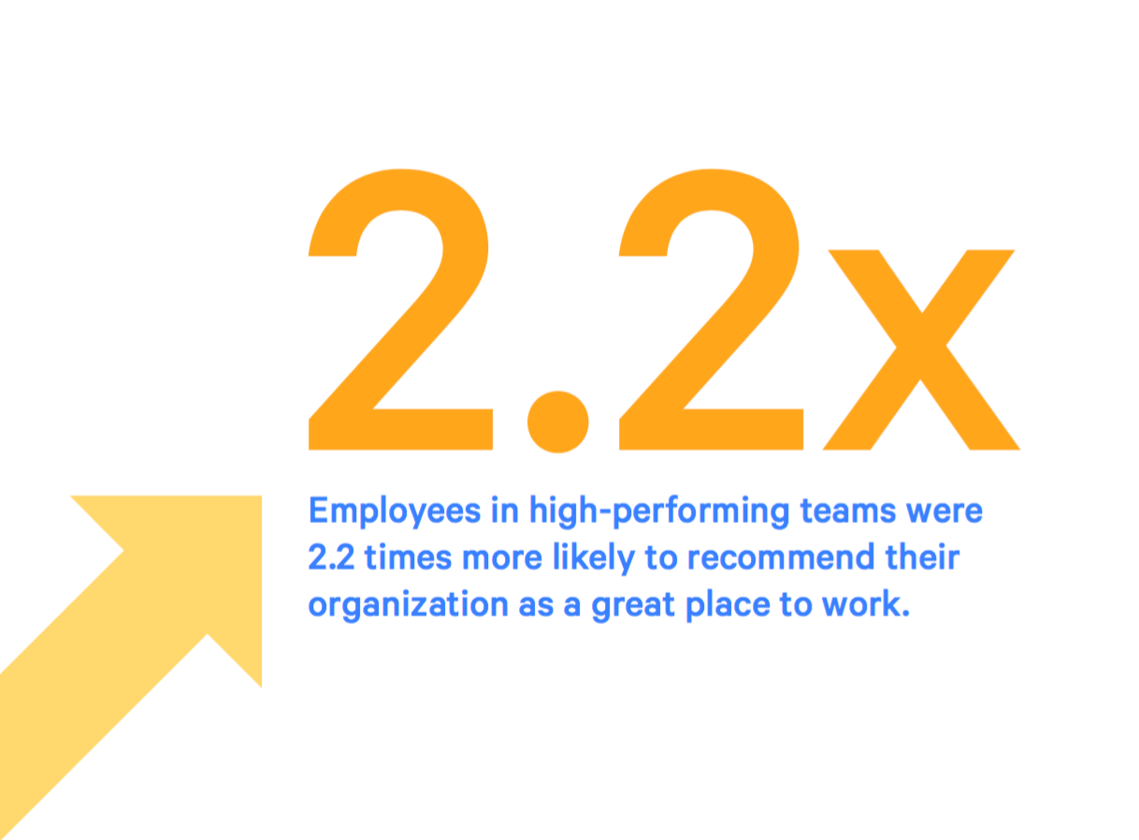
Source: 2016 State of DevOps Report

Slide 17
Infrastructure
What do we mean by “infrastructure”?
IT infrastructure provides all the necessary compute, storage, networking and software components necessary to deliver a service.

Slide 18

Traditional IT

Slide 19
Traditional IT
Hand-built infrastructure based on physical hardware and guided by experience.
Every infrastructure component is unique and special.
Built at different times with slightly different processes.
Built by different people with different levels of experience.
“Just make it work.”
Infrastructure is rarely replaced and is fanatically supported throughout its lifecycle.
Infrastructure changes are carefully controlled by a Change Advisory Board (CAB).

Slide 20
Traditional IT
Role of IT operations staff:
Gatekeepers for all IT services in the organization.
“The Office of No.”
Often partitioned into specialist teams:
Network engineers
Storage engineers
Security analysts
DBAs
Architects focused on the big picture.
Ops team focused on preventing infrastructure failure.
“Keep the lights on.”

Slide 21

Traditional IT server builds
The server build process:
Purchase request
Purchase order
Receive components
Build server
Test build/ update firmware
Install OS/Hypervisor
Test server
Rack server
Network provisioning
Storage provisioning
Firewall provisioning
Application server installation
Backup/ Monitoring provisioning
Disaster recovery provisioning
Security testing
Data migration
Application service testing
1 to 6 months later you have a server!

Slide 22

Modern IT

Slide 23
Modern IT
Design automated infrastructure that is repeatable and testable.
Humans build the machines that build the infrastructure.
Elimination of snowflakes – unique infrastructure components.
Infrastructure is constantly being replaced.
”We embrace change.”
Infrastructure changes are automated by a change management pipeline instead of a review board.

Slide 24

Modern cloud servers
The cloud server build process:
Review current computing budget quotas
Select pre-validated infrastructure stack
Deploy stack into virtual data center
Automatically load application services and data
2 minutes later you have a server!

Slide 25
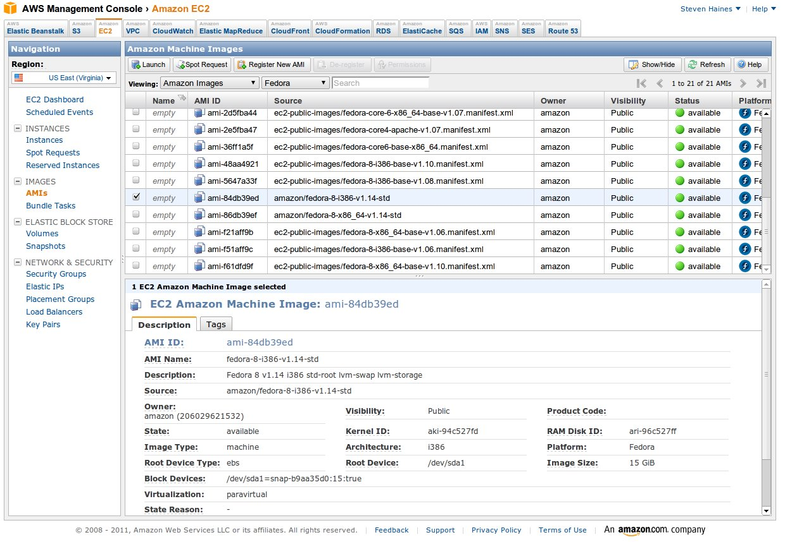
Cloud Infrastructure
Scripted,
automated
infrastructure
available on
demand from a
global cloud
computing service.
The fastest growing form of infrastructure today.
Gartner: 60% of Enterprise workloads will run in the cloud by 2018.

Slide 26

Topics this semester
Source control management
Automation
Shell scripting
Virtualization
Cloud computing
Infrastructure definition
Configuration Management
Containers
Code pipelines
Service orchestration

Slide 27
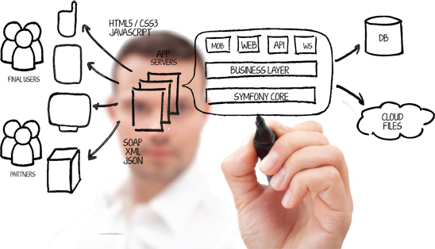
Course Syllabus

Slide 28
Syllabus Notes
This is a survey course and it will not turn you into a DevOps or cloud expert in 4 months.
It's not a management course. You will write code and work with technology every week.
Nobody is a true expert in all of these topics, including me. Share your knowledge and experience with the class.
Assignments will start out fairly prescriptive at first, but become less so over time.

Slide 29
Assignments
Quotes from students last few semesters:
Student 1: “The home work assignments were way too easy to complete.”
Student 2: “These were the most difficult assignments in my entire grad school experience. I spent 10 or more hours on each assignment…”
Student 3: “I was able to take lessons from your class and apply them at work the next day!”

Slide 30
Assignment Grading
Assignment grading is performed in a mostly automated fashion using a software test suite.
Assignments must pass a series of tests to receive full points.
#1 cause of losing points: missing files, incorrect file naming, incorrect file locations.
Case in file names matters!
Double-check your work.
Assignments must meet the requirements AND follow good engineering practices: clarity and maintainability.

Slide 31
Attendance

Slide 32
Source Control Management
Definition: “Version control, also known as source control, is the management of changes to documents, computer programs, large web sites, and other collections of information.” – Wikipedia
In our class, source control is about maintaining a history of all the changes made to code files.

Slide 33
Source Control Management
We use source control systems to:
Store and track changes in software source code and application configurations (or most any sort of text-based artifact)
Maintain different releases of software code
Effectively collaborate as a team on a single set of artifacts
First systems was SCCS, written in 1972 by Rochkind at Bell Labs.
Then came RCS, CVS, and Subversion
Dozens of commercial solutions available: Perforce, ClearCase, Microsoft TFS

Slide 34
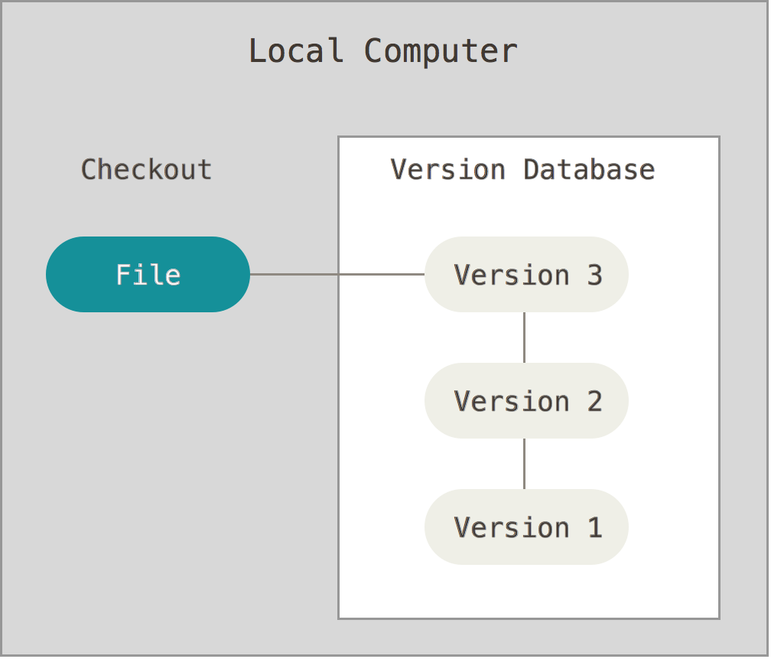
Types of source control
Local
Simple file
versioning
RCS
Image from https://git-scm.com/book/en/v2/Getting-Started-About-Version-Control

Slide 35
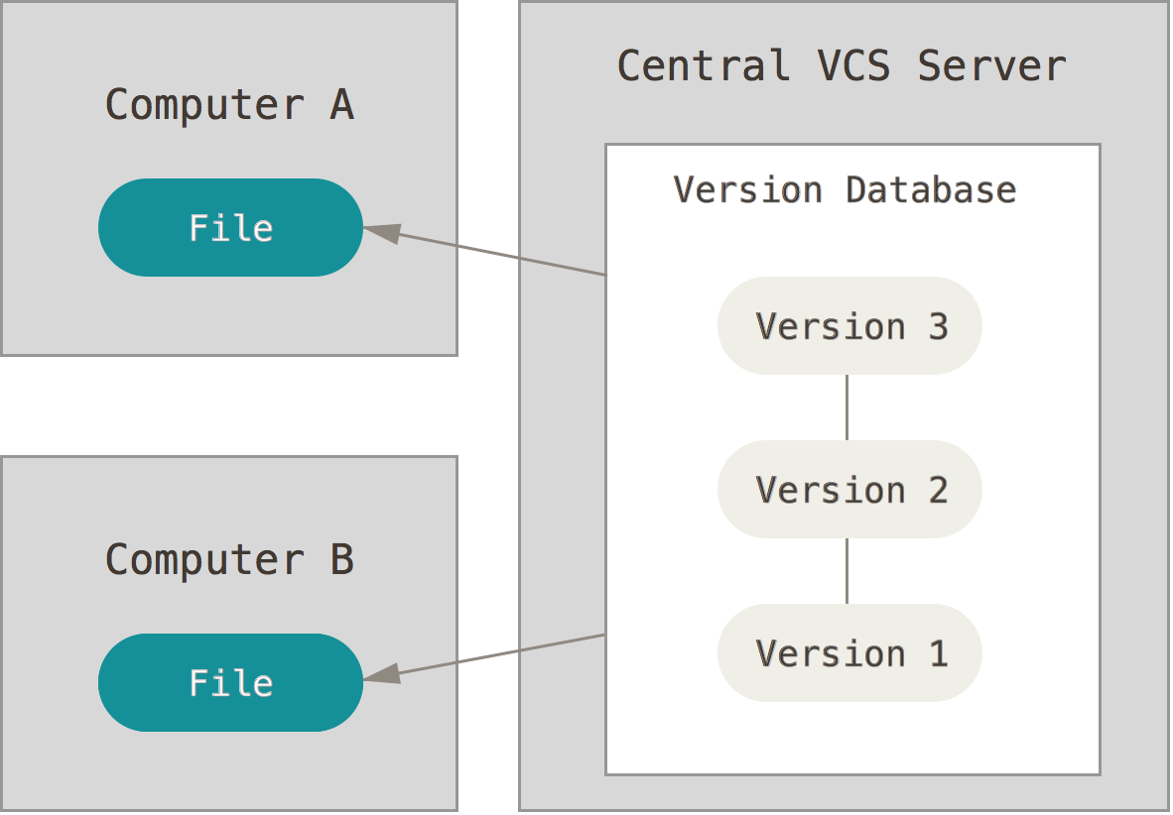
Types of source control
Centralized
Team approach
Everyone works
on same files
Central server = single point of failure
Hard to branch
Example: Subversion
Image from https://git-scm.com/book/en/v2/Getting-Started-About-Version-Control

Slide 36
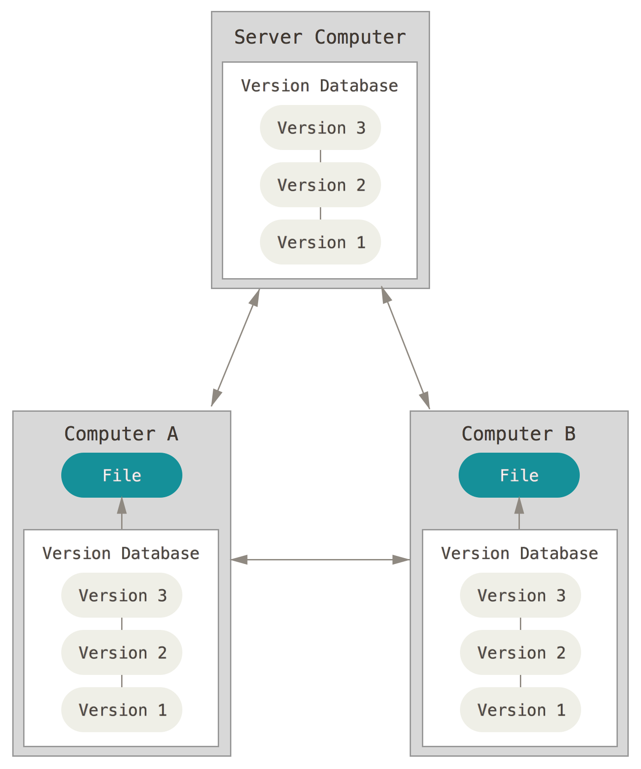
Types of source control
Distributed
Uses distributed team approach
Everyone works
on their own set of files
Easy to branch
Need to handle merge
conflicts
Example: Git
Image from https://git-scm.com/book/en/v2/Getting-Started-About-Version-Control

Slide 37
Git
Most popular open source distributed source control management system.
Initially designed by Linus Torvalds (Linux) in 2005.
Goals:
Super fast patching.
Supports one developer or thousands of developers.
Designed from a file-system perspective, not a source control management perspective.

Slide 38
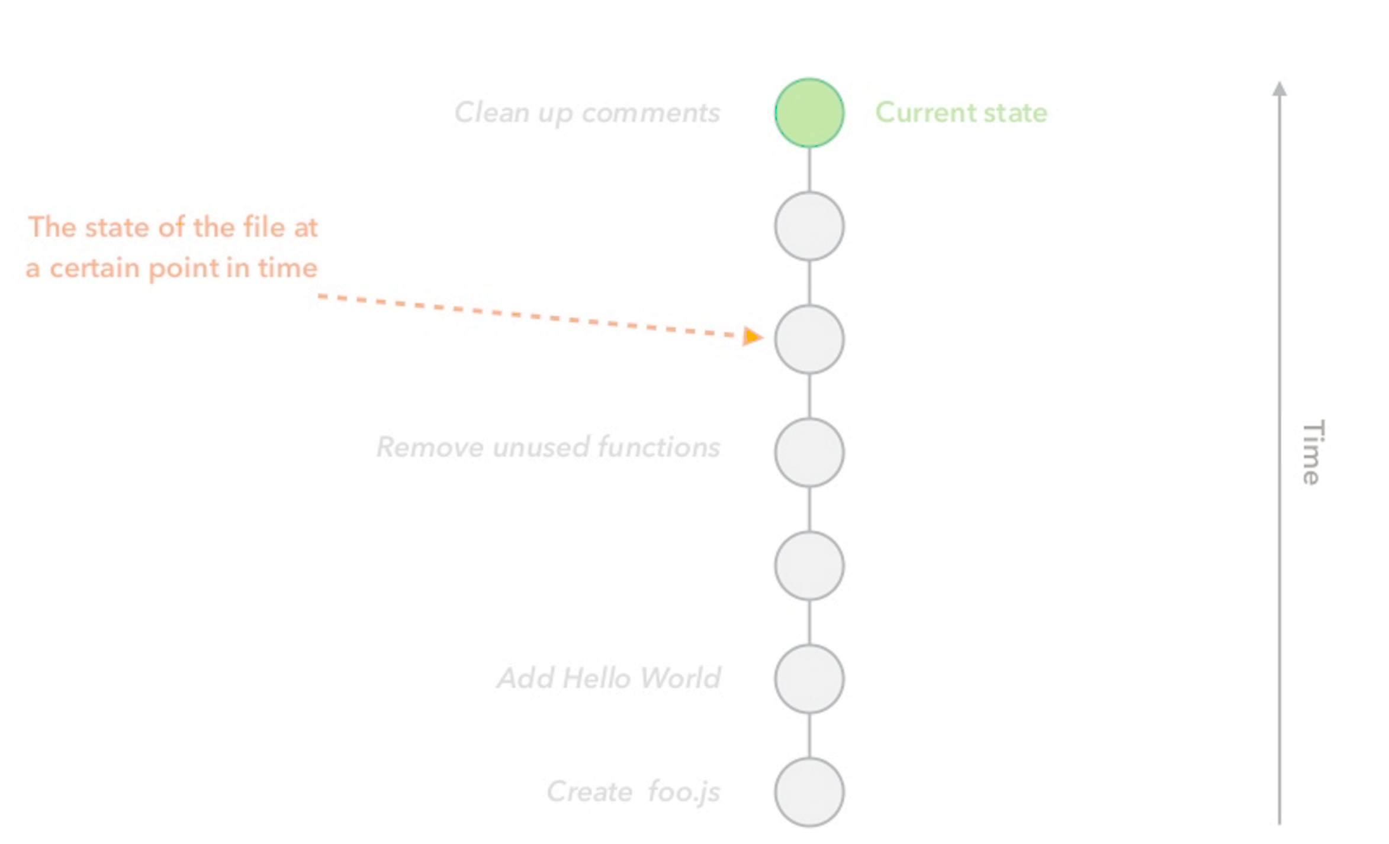
File
Source: An Introduction to Git by Hiroyuki Vincent Yamazaki

Slide 39
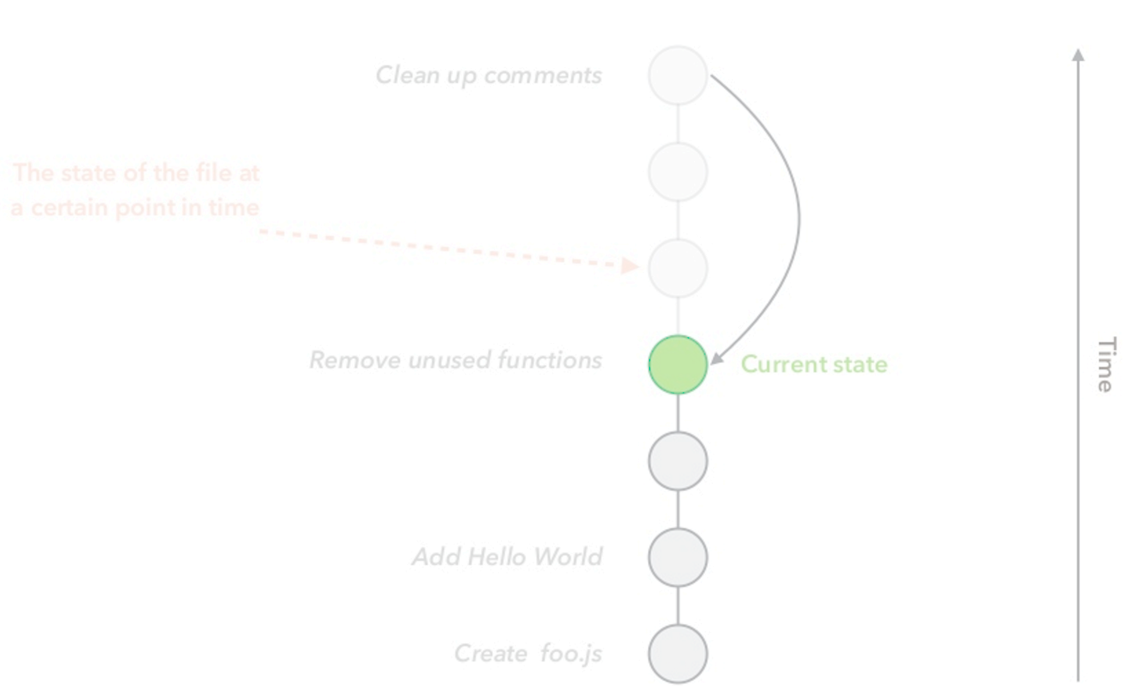
File
Source: An Introduction to Git by Hiroyuki Vincent Yamazaki

Slide 40
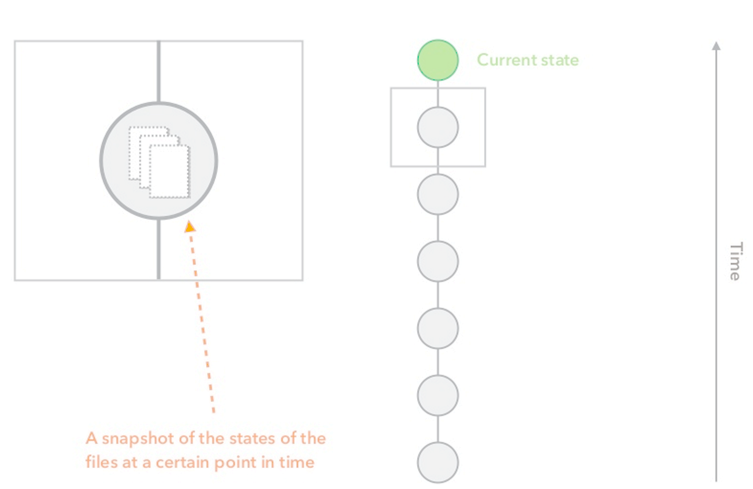
File(s)
Source: An Introduction to Git by Hiroyuki Vincent Yamazaki

Slide 41
Creating a Project
Start a new project:
> git init
Download an existing project:
> git clone <url>
Source: An Introduction to Git by Hiroyuki Vincent Yamazaki

Slide 42
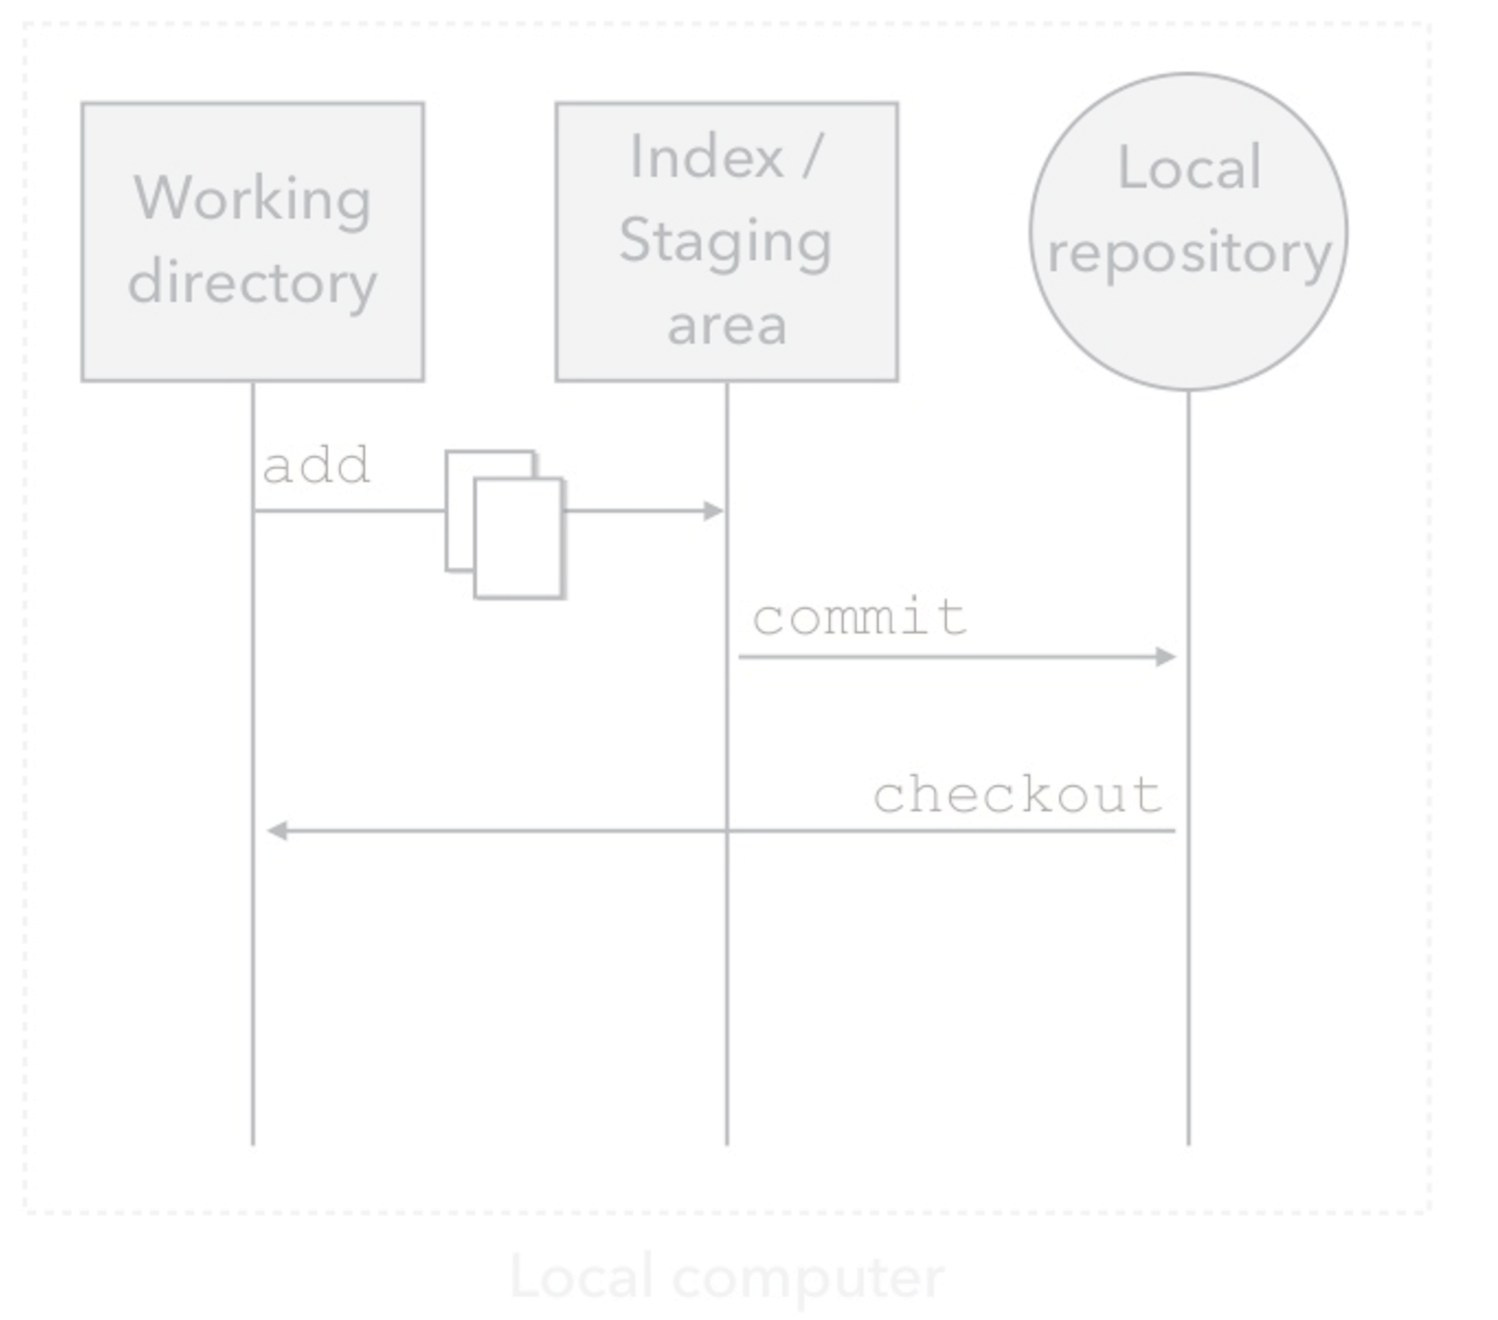
How Git works
Source: An Introduction to Git by Hiroyuki Vincent Yamazaki

Slide 43
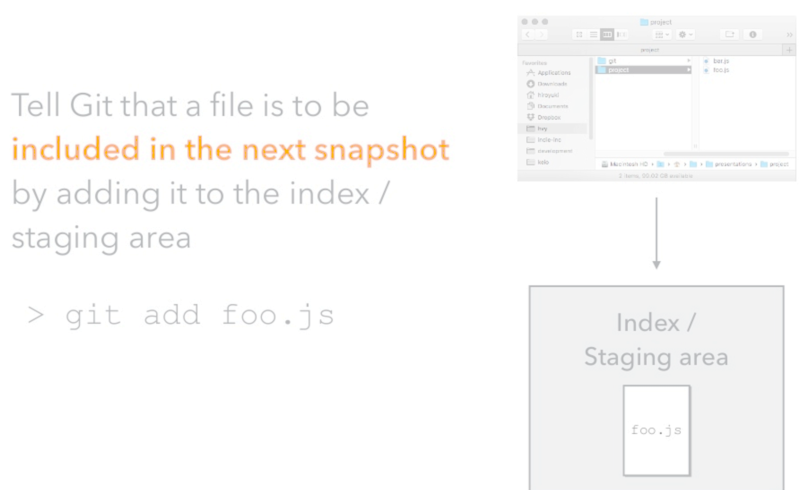
Add command
Source: An Introduction to Git by Hiroyuki Vincent Yamazaki

Slide 44
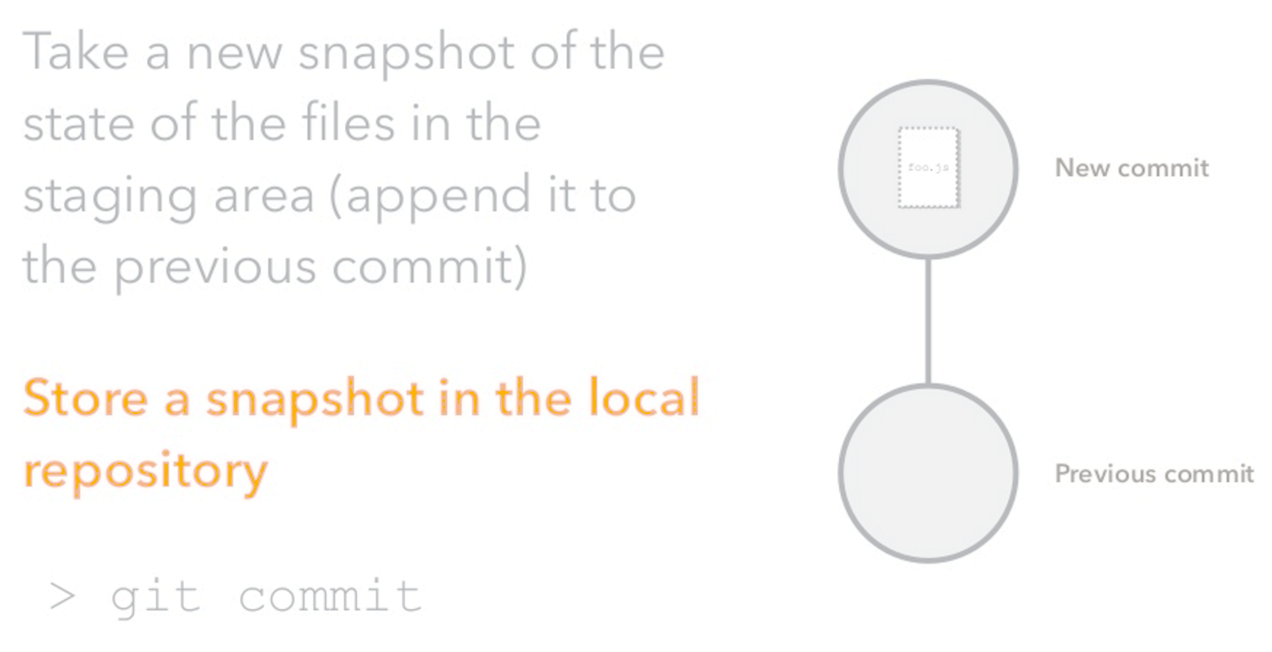
Commit command
Source: An Introduction to Git by Hiroyuki Vincent Yamazaki

Slide 45
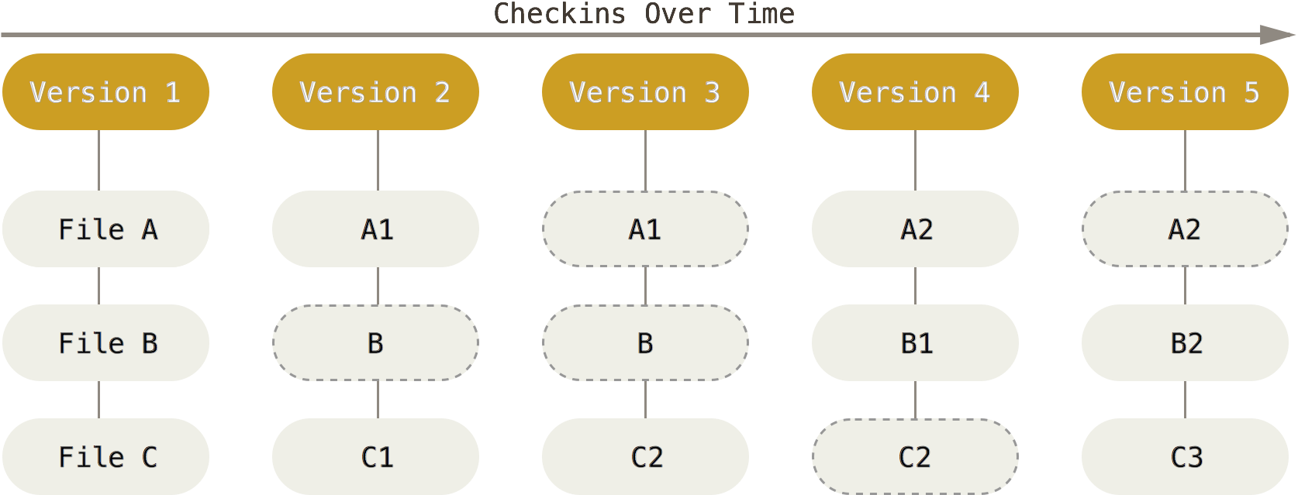
How Git Works
Git only creates new files when a file is modified.
Git stores references to files.
Image from https://git-scm.com/book/en/v2/Getting-Started-Git-Basics

Slide 46
Git Commits
Commits contain:
SHA-1 checksum (Commit Hash)
Author
Date
Message
Reference to parent commit(s)
Tree
Contains references to all the files in the snapshot
Source: An Introduction to Git by Hiroyuki Vincent Yamazaki

Slide 47
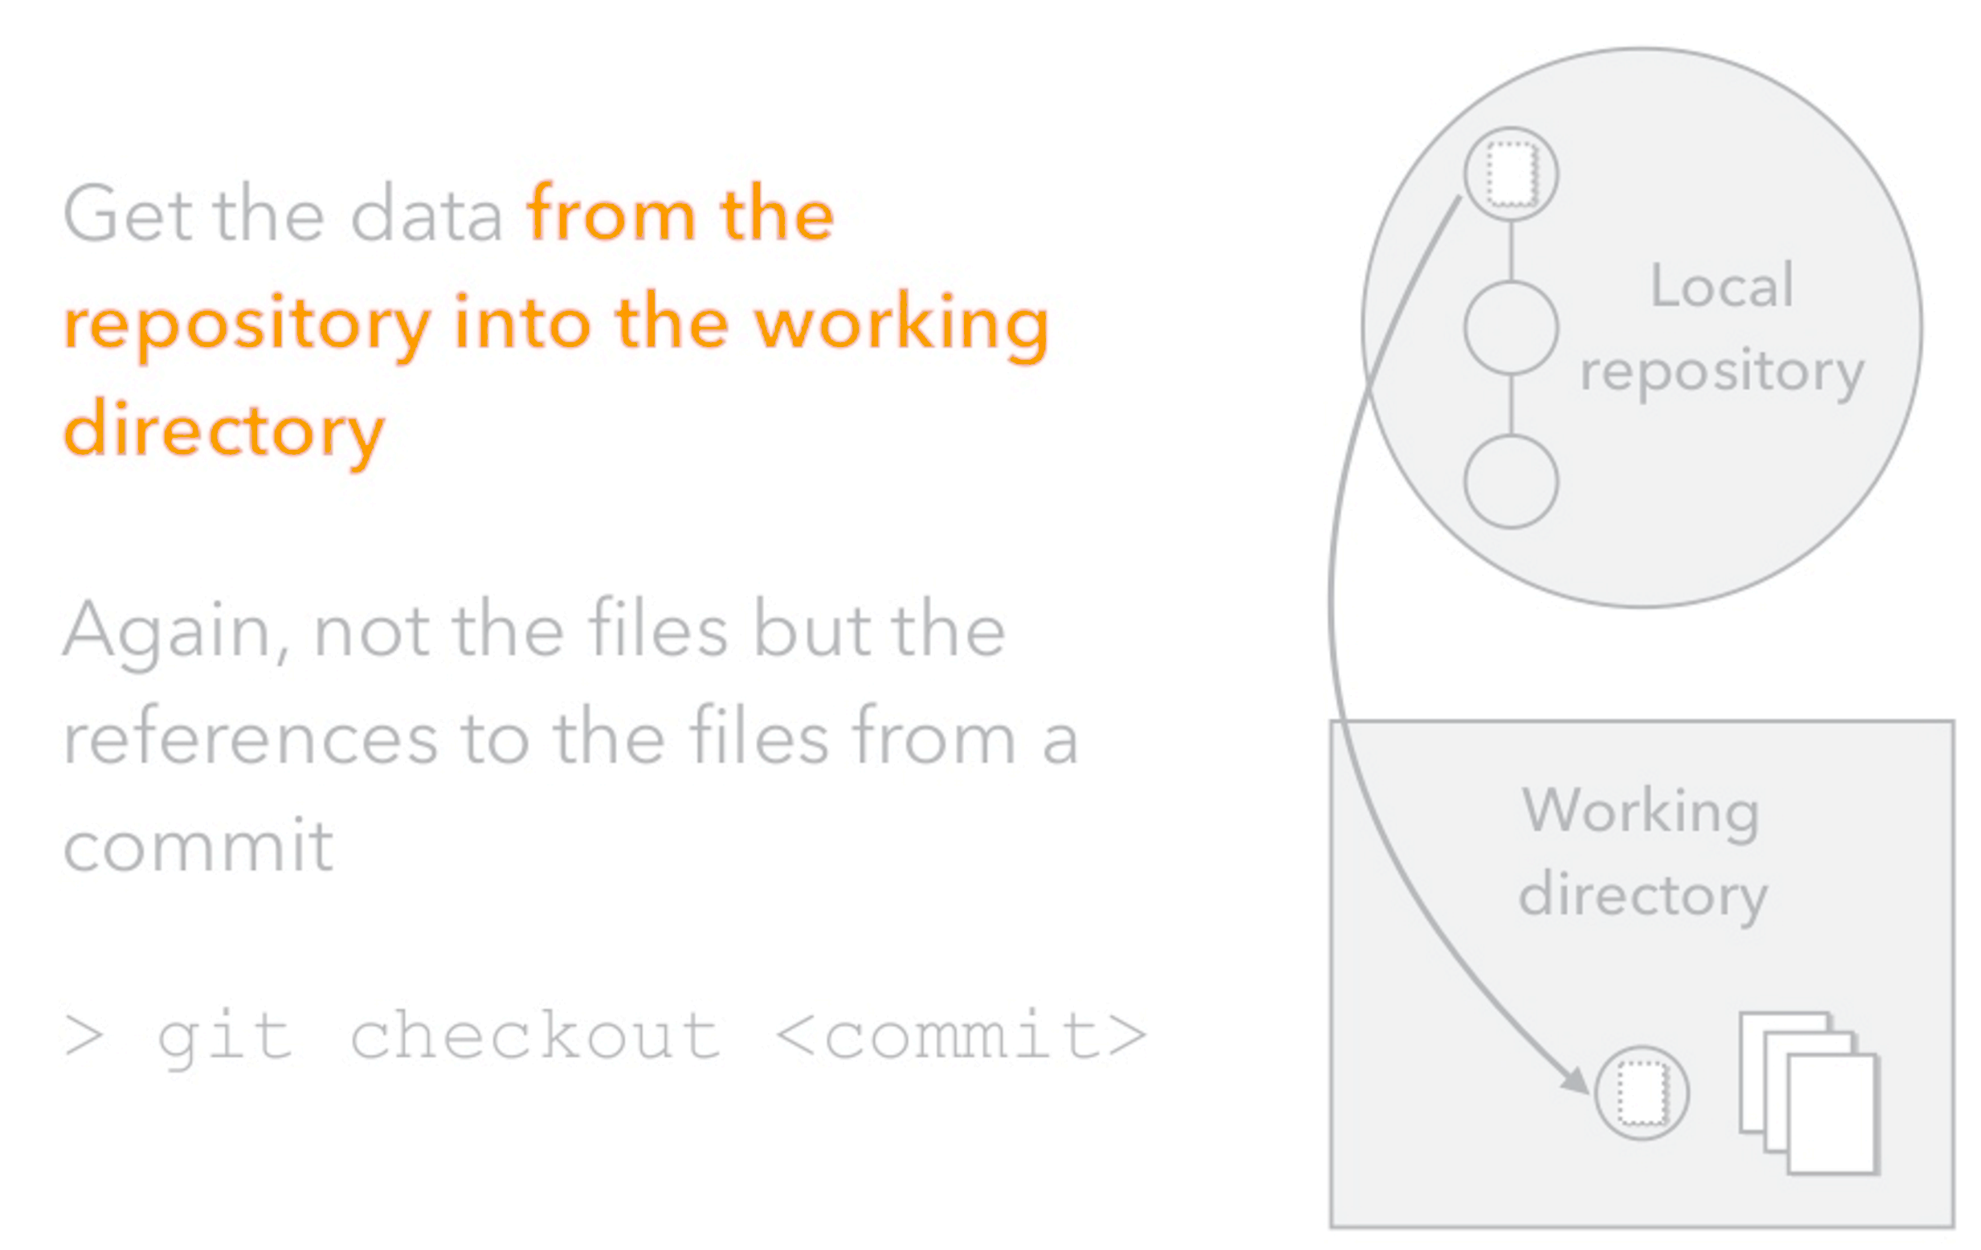
Git Checkout
Source: An Introduction to Git by Hiroyuki Vincent Yamazaki

Slide 48
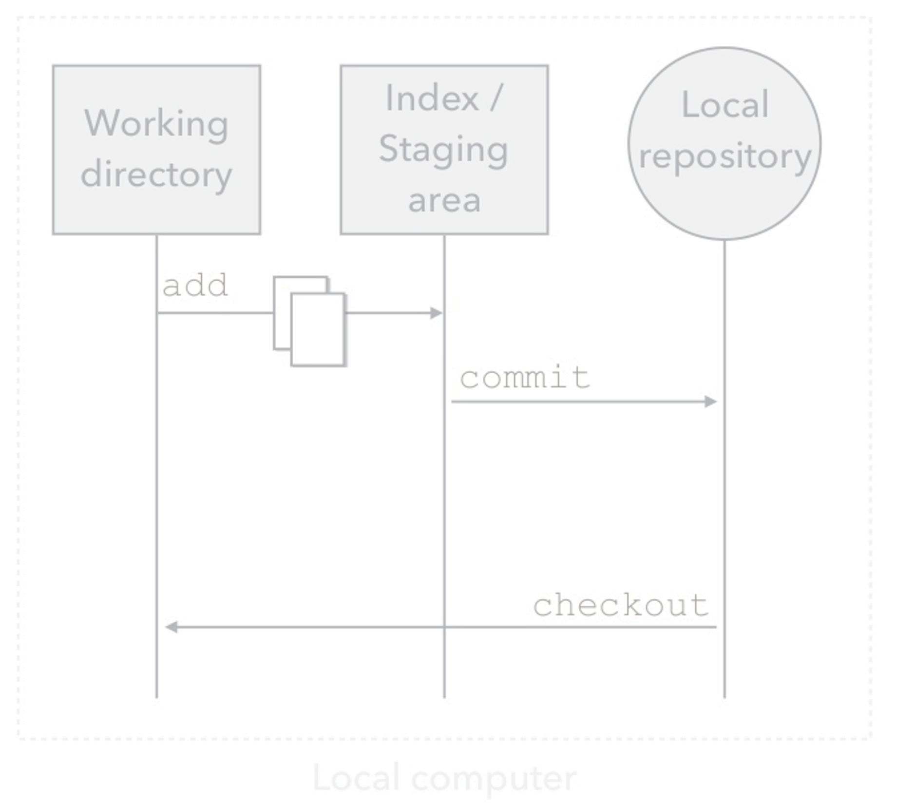
Git Collaboration
Source: An Introduction to Git by Hiroyuki Vincent Yamazaki

Slide 49
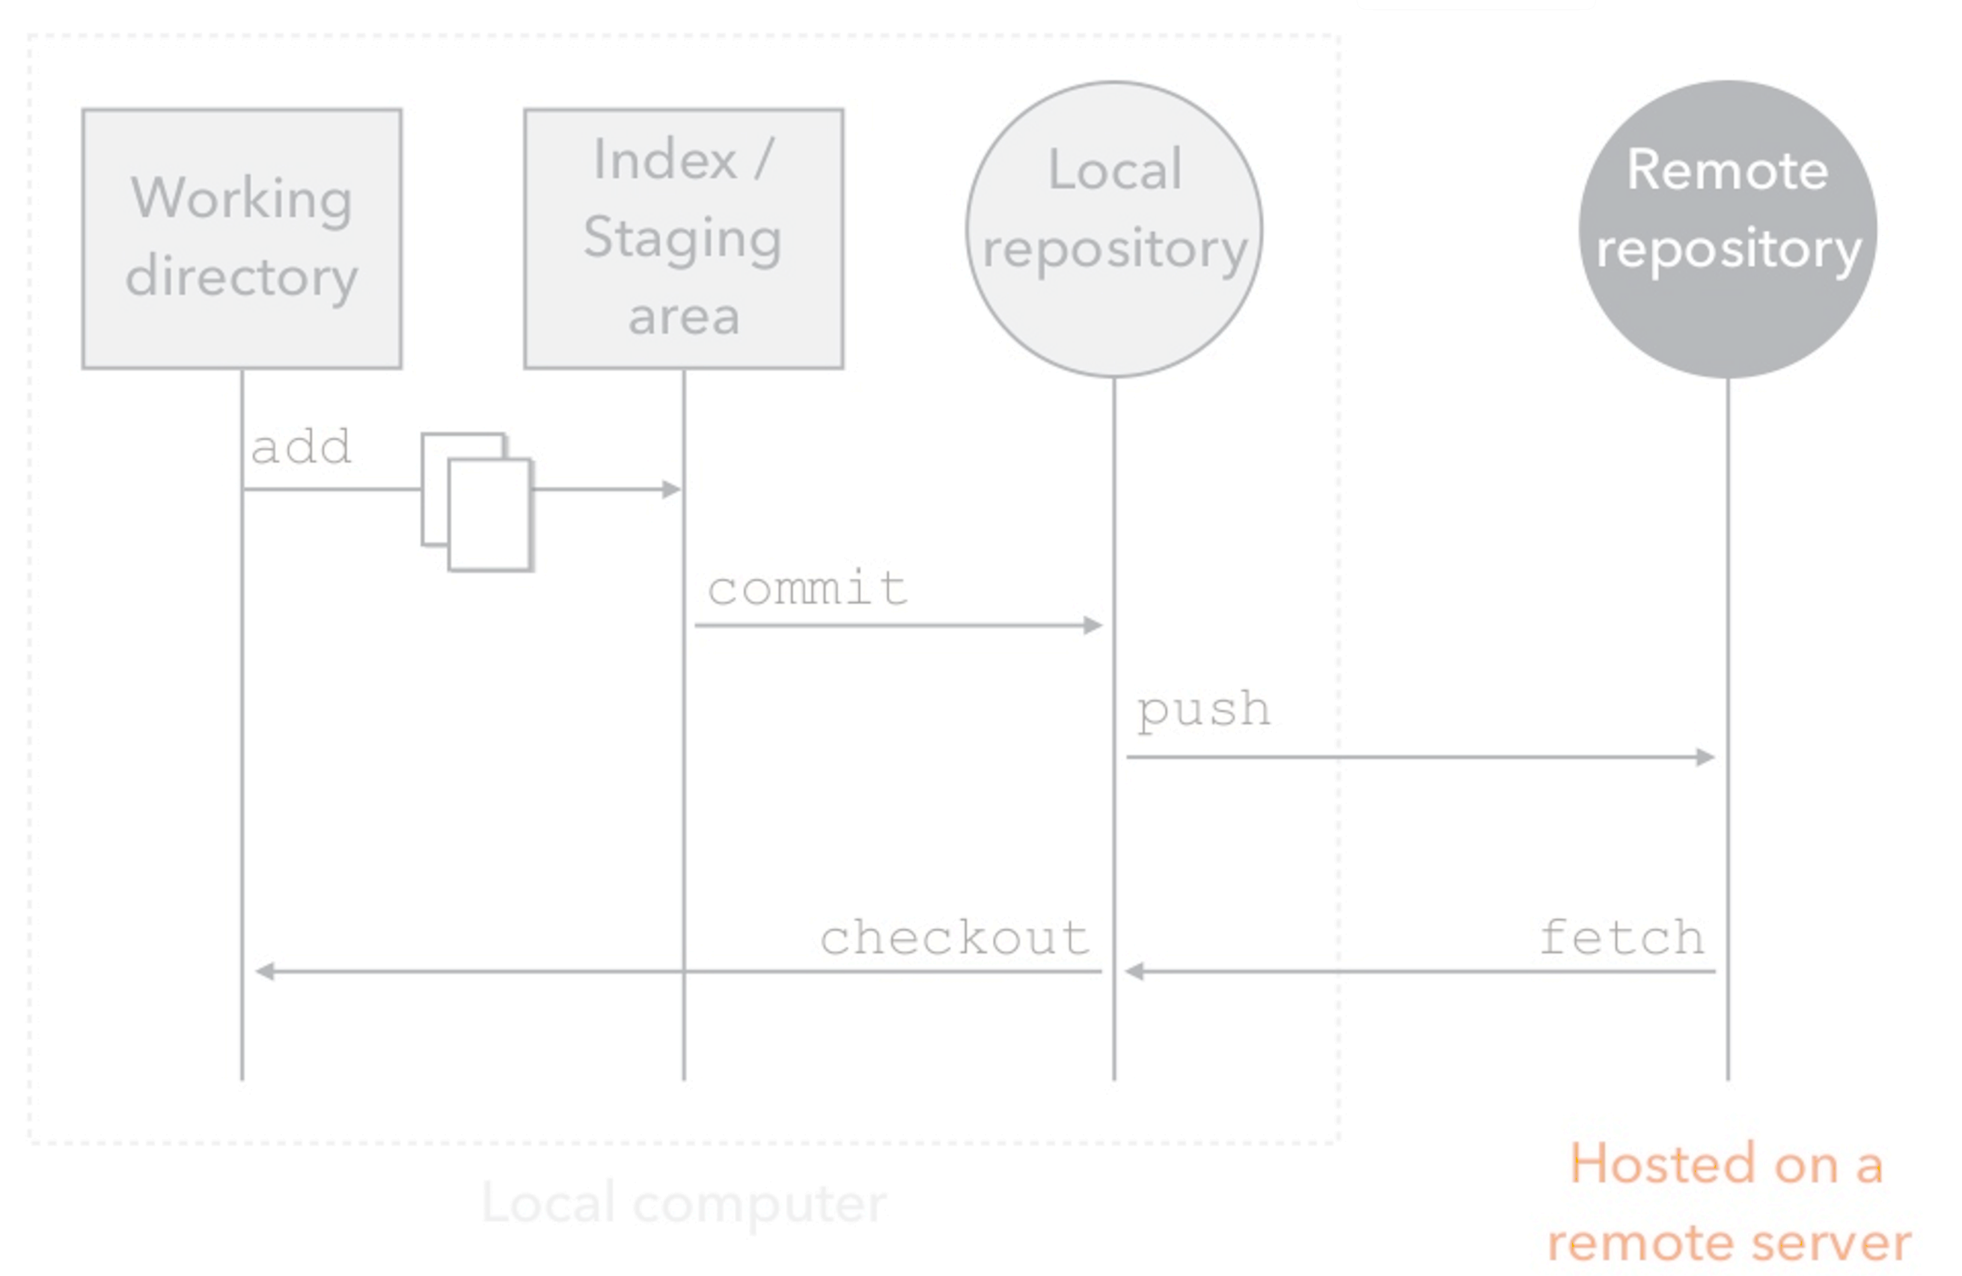
Git Collaboration
Source: An Introduction to Git by Hiroyuki Vincent Yamazaki

Slide 50
Remote Repository
The remote repository is a copy of the local repository hosted on a network.
Other people can clone the remote repository to download their own copy.
GitHub provides a place to host a remote repository.
Source: An Introduction to Git by Hiroyuki Vincent Yamazaki

Slide 51
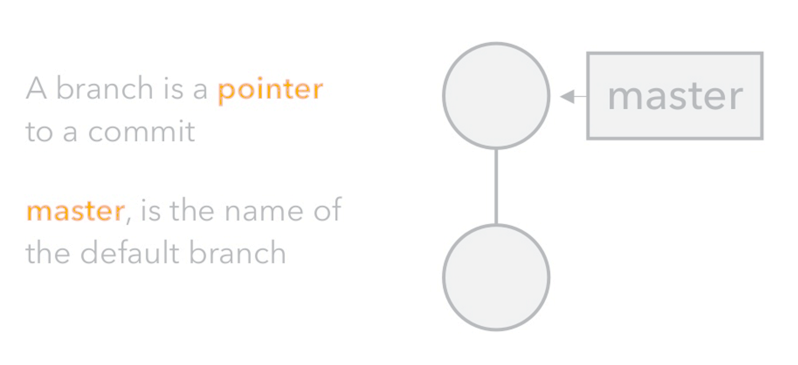
Git Branch
Source: An Introduction to Git by Hiroyuki Vincent Yamazaki

Slide 52
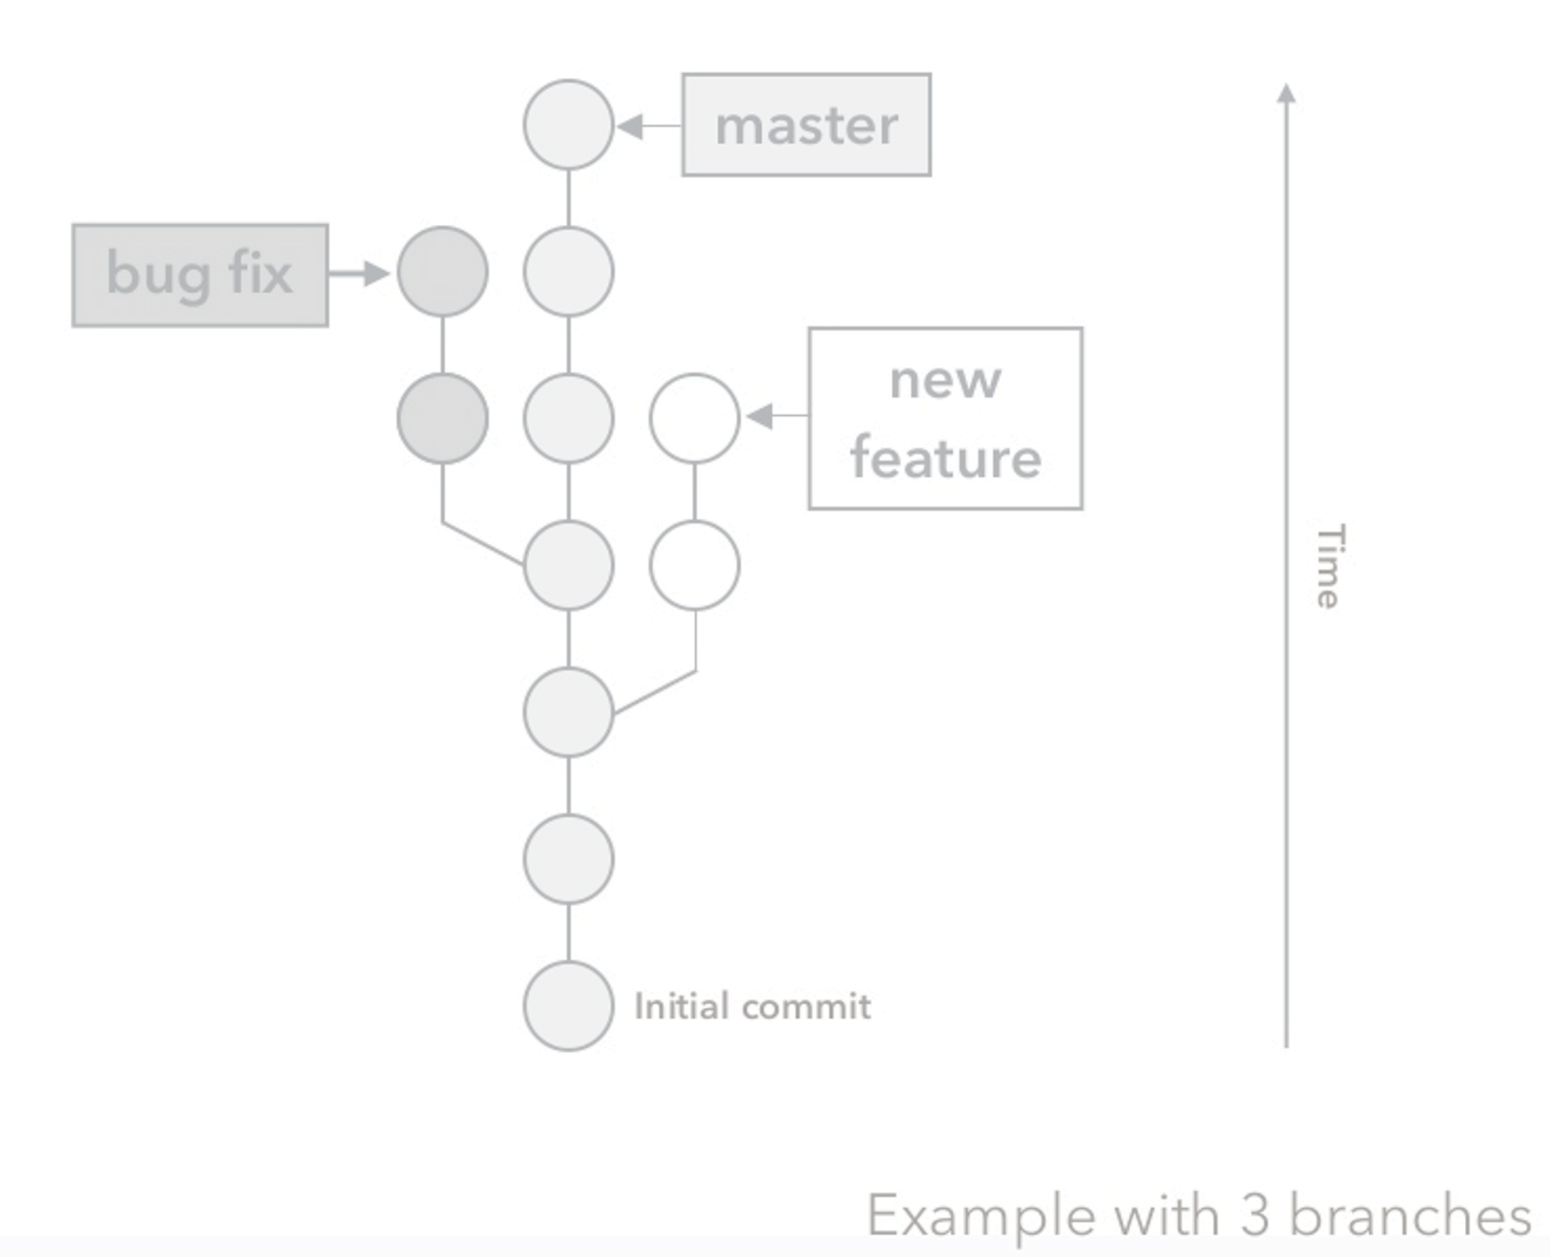
Git Branch
Source: An Introduction to Git by Hiroyuki Vincent Yamazaki

Slide 53
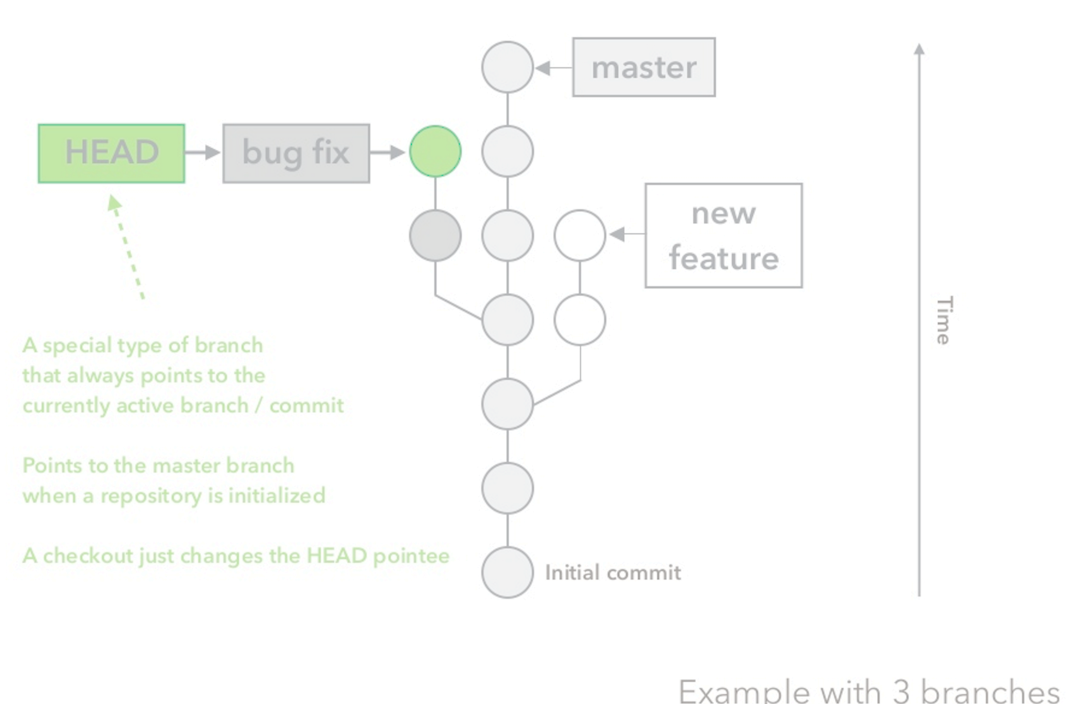
Git Branch
Source: An Introduction to Git by Hiroyuki Vincent Yamazaki

Slide 54
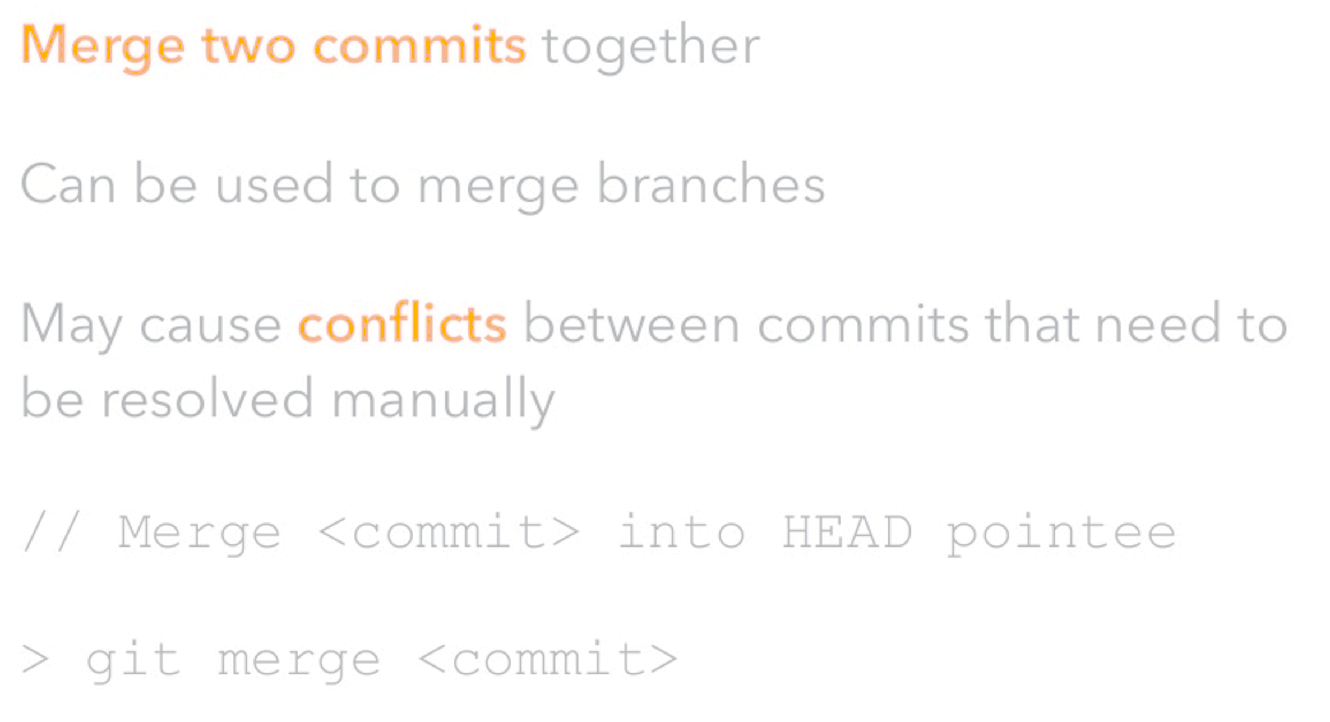
Git Merge
Source: An Introduction to Git by Hiroyuki Vincent Yamazaki

Slide 55
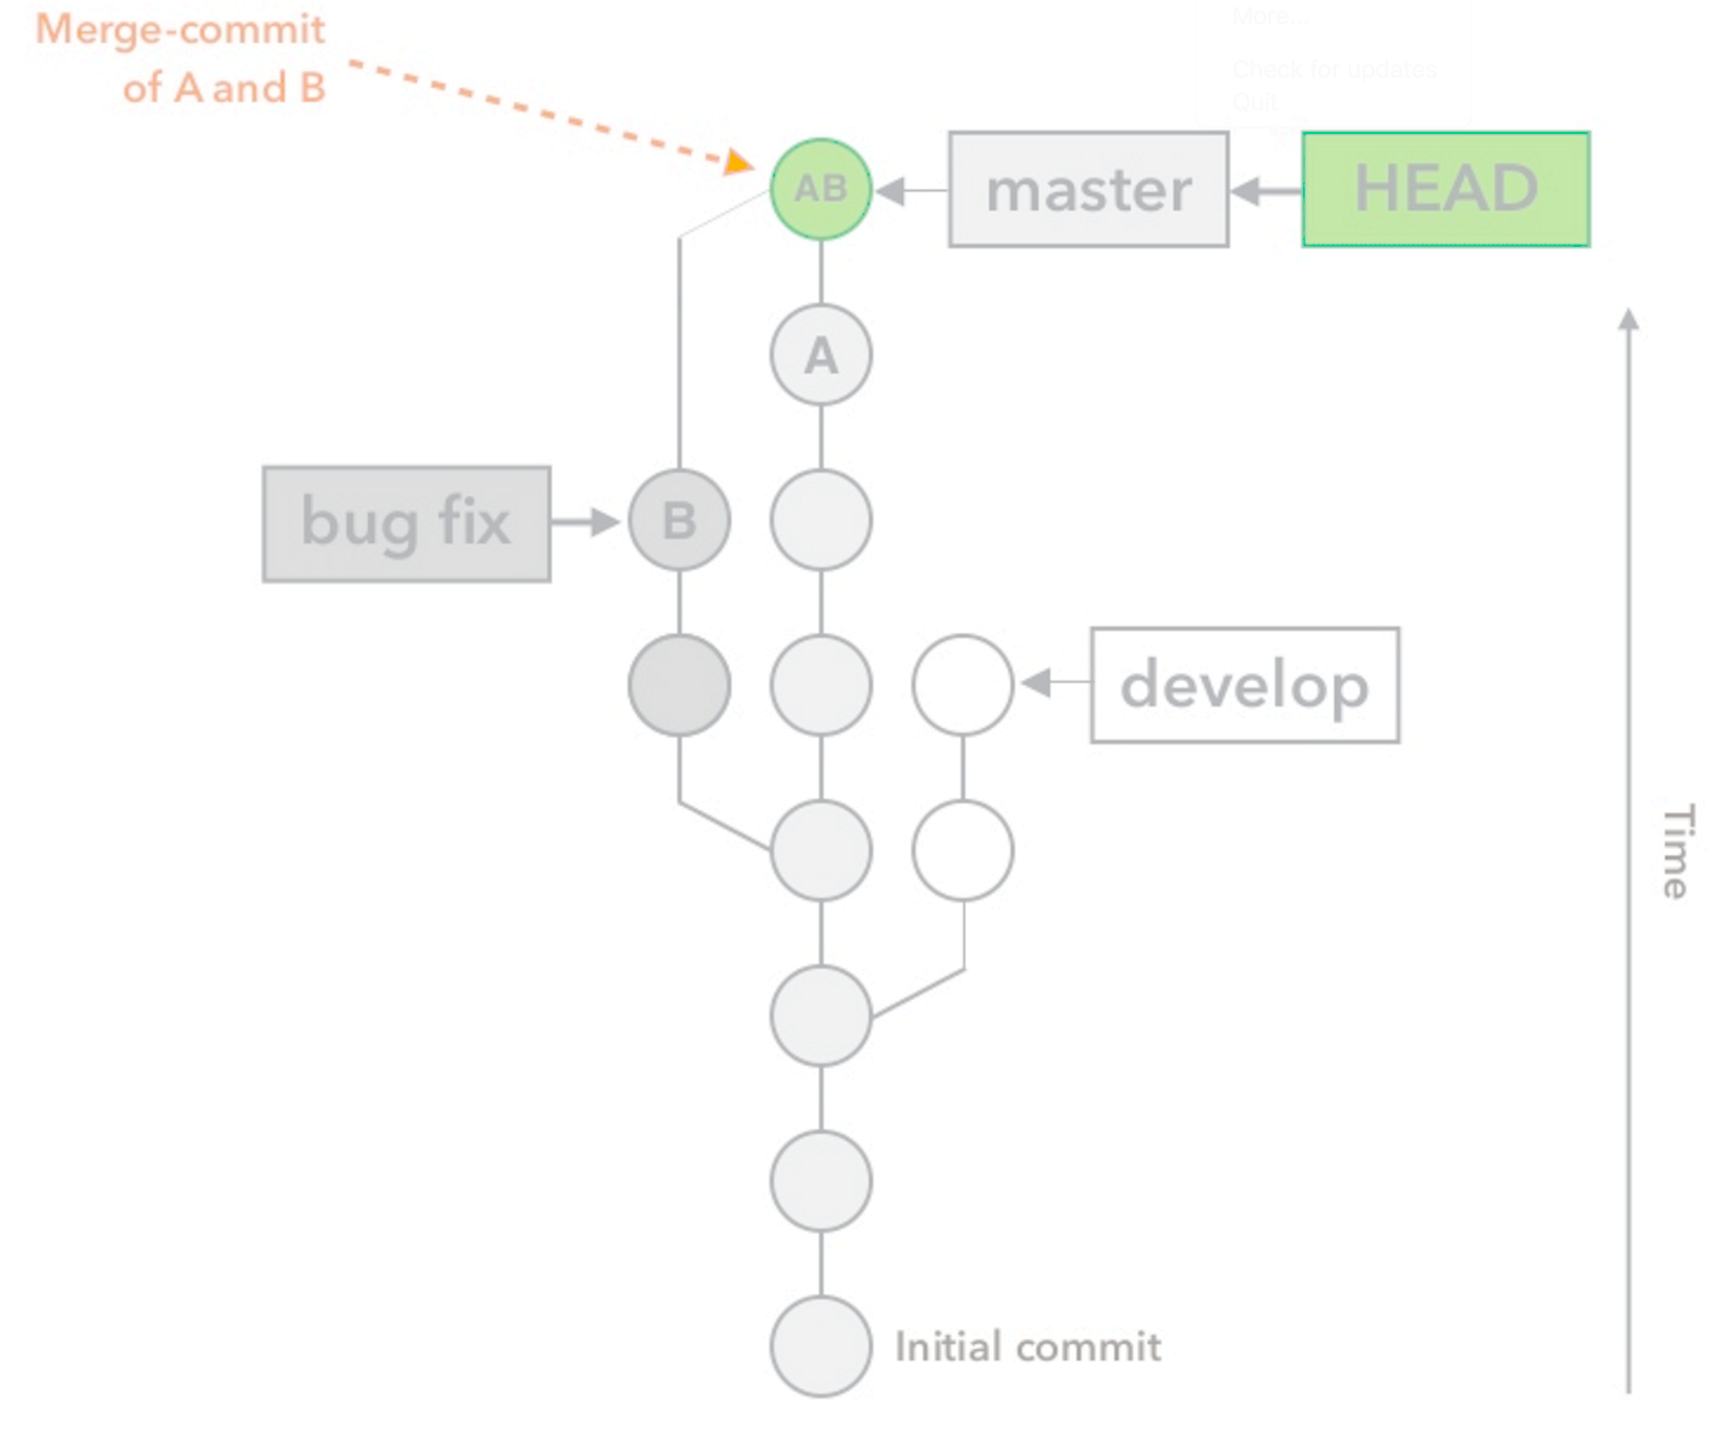
Git Merge
Source: An Introduction to Git by Hiroyuki Vincent Yamazaki

Slide 56
Git Hands-on
The best way to learn Git is by using the git command using a command line interface (terminal shell)
You can also use graphical Git clients such as Source Tree
These are very helpful when working with large teams
Refer to Git Hands-On Guide
Book: https://git-scm.com/book/en/v2

Slide 57
Git Hands-on
MacOS Commands:
mkdir project1
$ cd project1
$ git init
$ touch data.json
$ git status
$ git add data.json
$ git commit -m “my first commit”
$ touch nginx.conf
$ git status
$ git add nginx.conf
$ git commit -m “add web configuration file”
$ git checkout <1st commit hash>
$ git checkout <2nd commit hash>
$ git branch develop
$ git checkout develop
$ touch index.html
$ git add *
$ git commit -m “add homepage”
$ git checkout master
$ git merge develop master
Windows Commands:
$ mkdir project1
$ cd project1
$ git init (use gitup for visual learning)
$ ECHO >> data.json
$ git status
$ git add data.json
$ git commit -m “my first commit”
$ ECHO >> nginx.conf
$ git status
$ git add nginx.conf
$ git commit -m “add web configuration file”
$ git checkout <1st commit hash>
$ git checkout <2nd commit hash>
$ git branch develop
$ git checkout develop
$ ECHO >> index.html
$ git add *
$ git commit -m “add homepage”
$ git checkout master
$ git merge develop master

Slide 58
Homework
Assignment 1: Set up accounts
Read Git Hands On Guide
Read Linux Hands On Guide
Watch Lecture 2 videos

